Slide 1
Unit – III
Part-A
Solar energy collection
Flat plate collectors
Concentrating collectors
Classification of concentrating collectors
Orientation

Slide 2
Solar energy conversion into heat:
Solar energy can be converted into heat using a variety of devices and technologies, including collectors, solar cookers, solar thermal panels, and concentrated solar power etc.
The solar energy conversion into heat by solar collectors was mentioned below.
Solar collectors:
Solar energy reaching earth’s surface has small intensity of about 5–7.5 kWh/ m².
Solar collector is a device for collecting solar radiation and then transferring the absorbed energy to a fluid passing through it.
A solar collector absorbs solar energy in the form of heat and simultaneously transfers this heat to a fluid so that the heat can be transported by the fluid.
The transport fluid takes this transferred heat from the collector and delivers it to a thermal storage tank.
Hence, solar collector is essential and it forms the first basic unit in a solar thermal system.

Slide 3
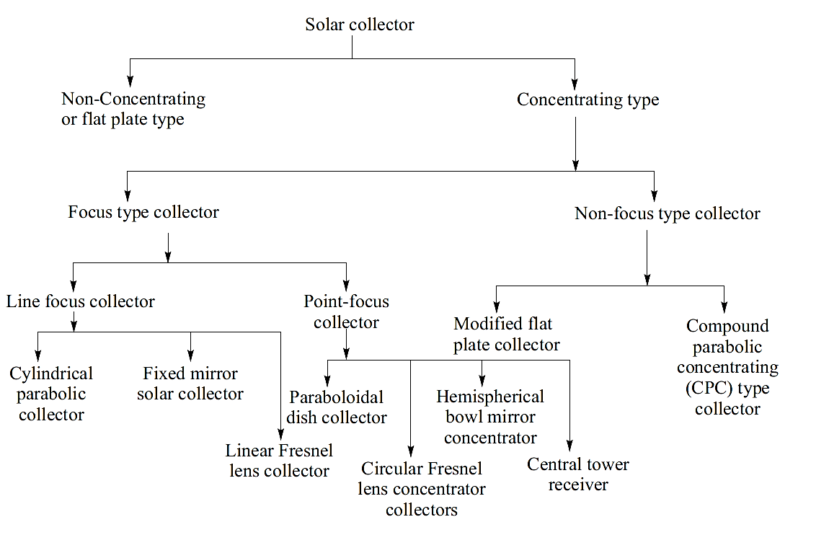
Classification of solar collectors:
Fig: Classification of solar collector

Slide 4
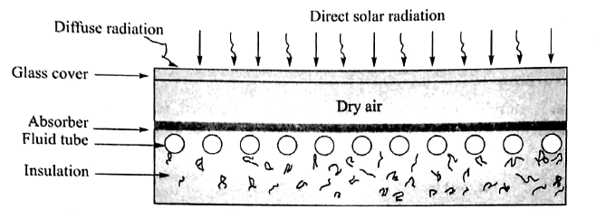
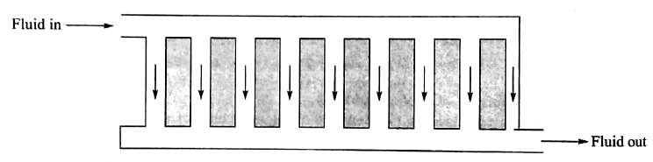
Flat plate collectors:
Principle of conversion:
If incident radiation is unity on a body, then radiation can be absorbed, reflected, transmitted. If absorption coefficient, reflection coefficient and transmission coefficient are α, ρ and τ, respectively, then
α+ρ+τ=1
α … Absorption coefficient
ρ … Reflection coefficient
τ … Transmission coefficient
Components of flat plate collector:
i) Absorber plate
ii) Transparent cover
iii) Fluid tubes or channels
iv) Thermal insulation
v) Tight container or box
Fig: Layout of flat plate collector
Fig: Fluid Tube connection and Fluid Flow

Slide 5
Absorber Plate:
It is meant to intercept and absorb incident solar radiation. It is primarily a blackened heat absorbing plate usually made of copper, aluminum or steel. It may also be given a coating to minimize the emission of heat from its surface.
Transparent Cover:
It is made of one or more transparent sheets of glass or plastic. It is placed above the absorber plate. The cover allows radiation to reach the absorber plate but it prevents any re-radiation and heat loss due to convection.
Fluid Tubes or Channels:
Fluid tubes or channels are arranged in thermal contact with the absorber plate so that heat can be transferred from the absorber plate to the fluid in the tubes or channels.
Thermal Insulation:
The thermal insulation is provided under the absorber plate and fluid tubes to minimize any heat loss by transmission or convection from the absorber plate and fluid tubes.
Tight container or box:
All the above components of the collector are protected by a tight container or box as shown in figure.

Slide 6
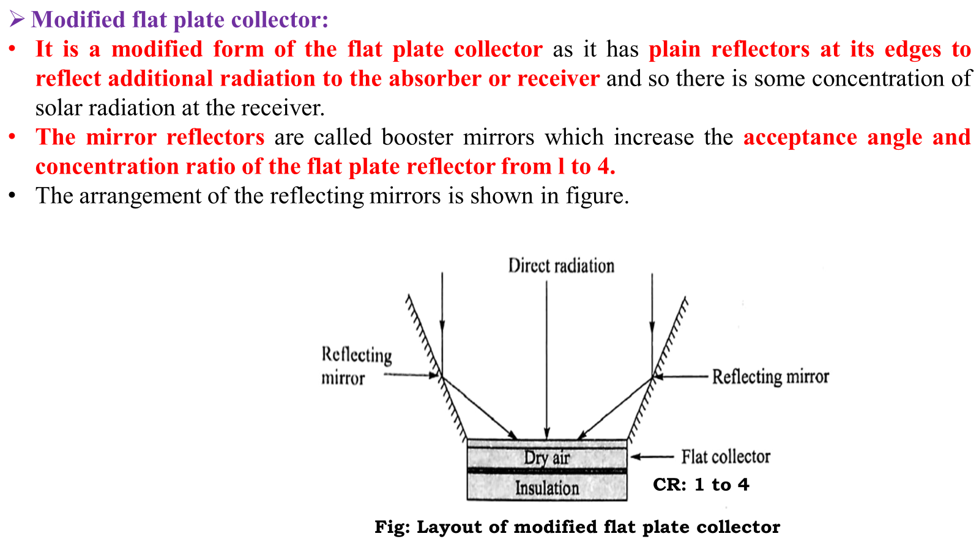
The characteristic features of a flat plate collector are as follows: i) It absorbs both direct and diffuse solar radiation. ii) It does not need any sun tracking system. Hence, it is mechanically stronger than other collectors which require tracking system. iii) It has simple construction iv) Requiring a little maintenance.

Slide 7
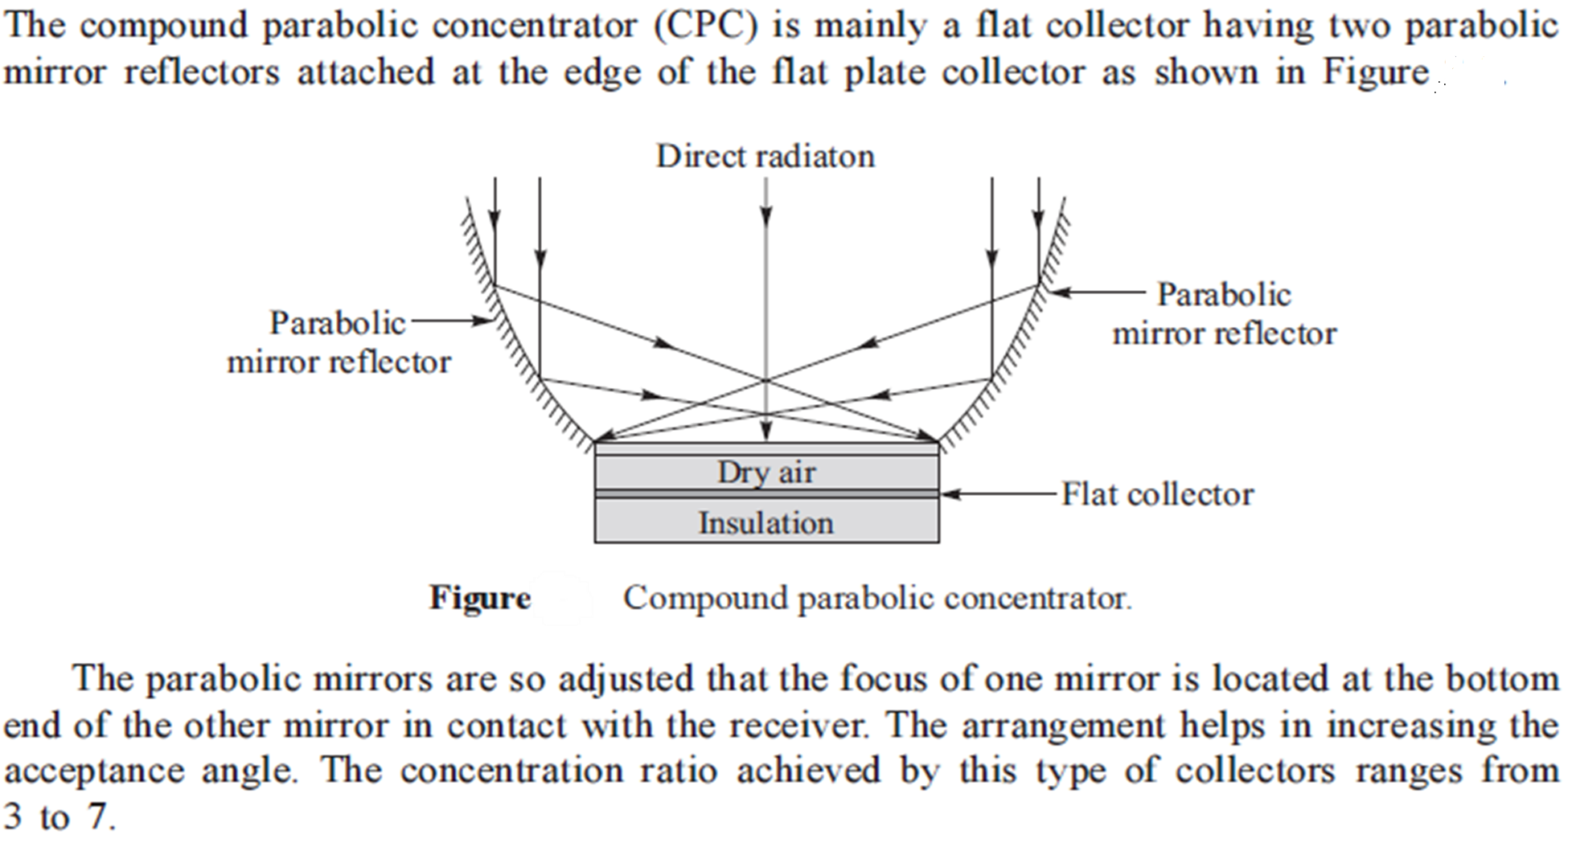
Compound parabolic concentrator:

Slide 8
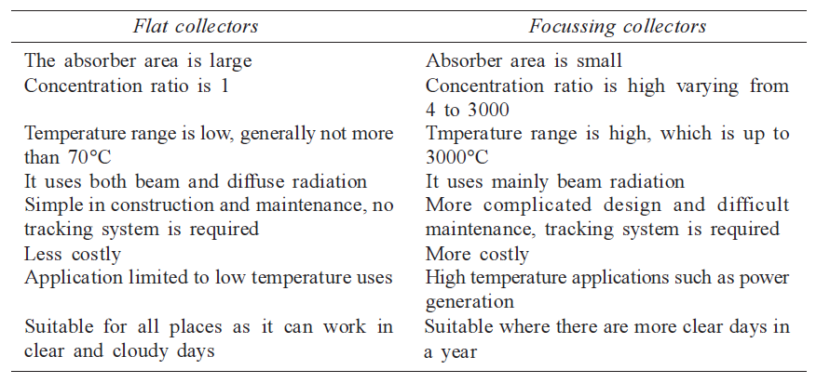
Advantages of flat plate collectors: →In Flat Plate Collectors it used to collect the energy from all directions which are from above the observer. →This is a non-pollution type system →This can collect the direct and diffuse solar radiation →The power we use for this is renewable energy (sun) →Construction is easy Disadvantages of flat plate collectors: →Need a backup heater →Solar hot water systems aren’t compatible with boilers →Flat plate collectors can be less efficient than other systems
Comparison between flat and focussing collectors:

Slide 9
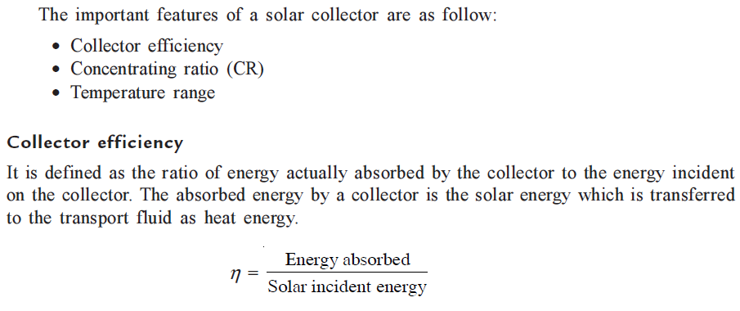
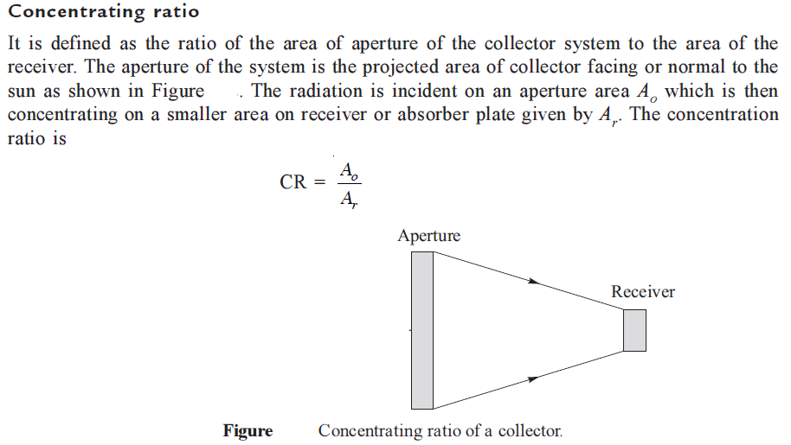
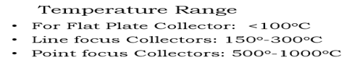
Features of solar collectors:
Temperature range: It is the range of the temperature to which the heat transporting fluid is heated up by the collector.

Slide 10
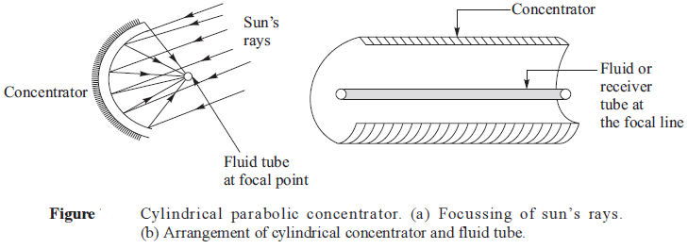
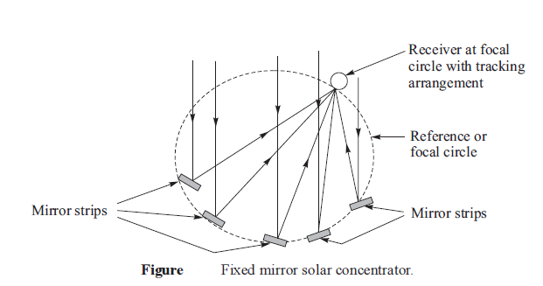
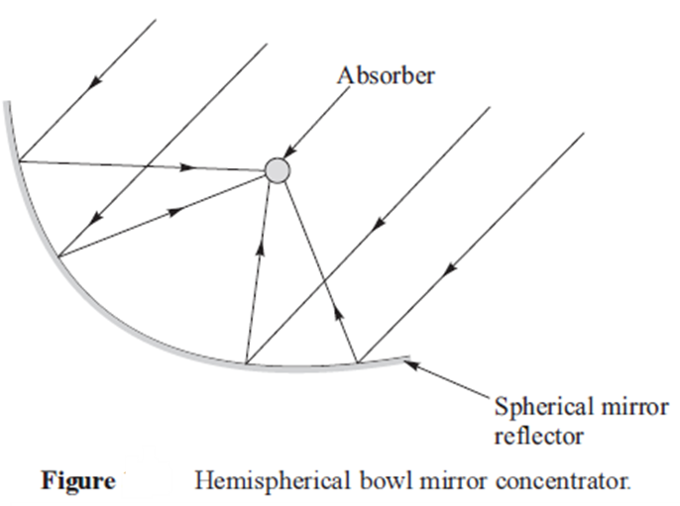
Focus type collectors:

Slide 11
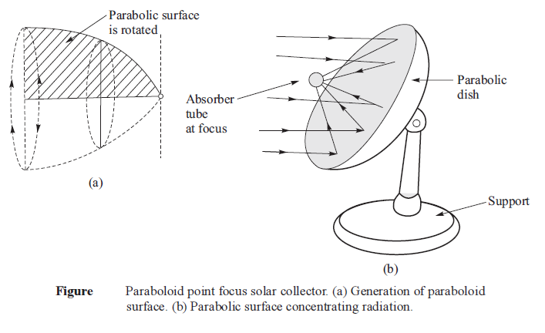
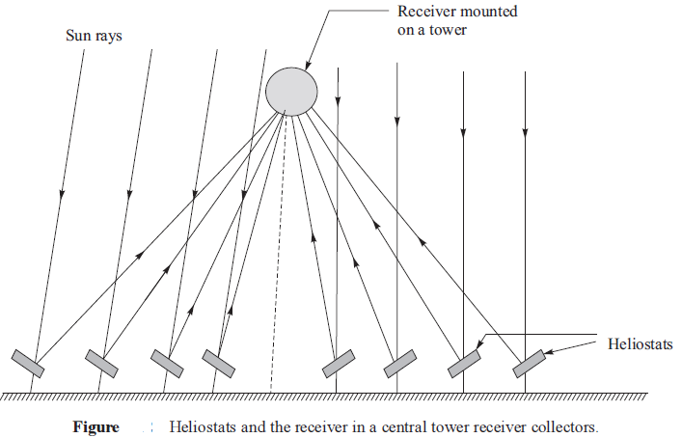
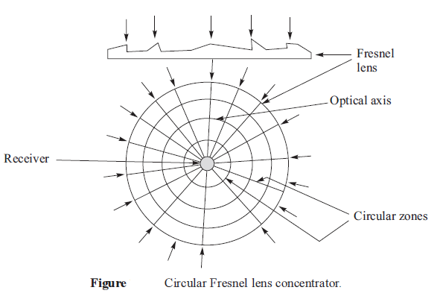

Slide 12
Unit – III
Part-B
Solar energy storage and applications
Different methods of solar energy storage:
Sensible heat storage
Latent heat storage
Stratified storage
Solar ponds
Solar applications:
Solar heating technique
Solar cooling technique
Solar distillation
Solar drying
Solar cookers
Central power tower concept
Solar chimney

Slide 13
Solar energy storage:
The solar energy storage systems can be classified as follows:
Thermal energy storage system
Stratified storage
Chemical energy storage system
Electrical energy storage system
Hydrogen energy storage system
Electromagnetic energy storage system
Biological storage system
Thermal energy storage:
Thermal energy storage can be applied in two ways
Sensible heat storage by the virtue of heat capacity and the change in temperature of the material.
Latent heat storage by the virtue of latent heat necessary to change the phase of the storage medium.

Slide 14
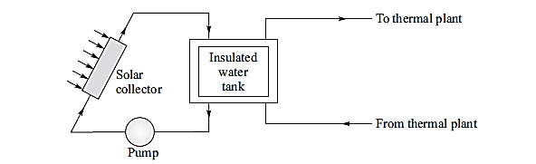
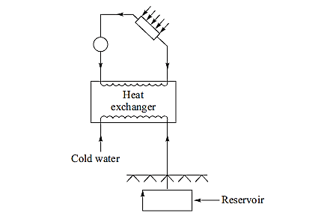
i. Sensible heat storage:
Fig: Short-term sensible heat storage by water
Fig: Long-term sensible heat storage by water

Slide 15
Thermal energy is stored in this type of storage by virtue of heat capacity and temperature difference developed during charging and discharging.
The temperature of the storage material rises when thermal energy is absorbed and temperature drops when thermal energy is taken out.
In this storage, the charging and discharging can be performed reversibly for an unlimited number of times.
The sensible heat storage can be liquid media storage and solid media storage.
Water is considered as the most suitable media for storage below l00°C.
Liquids such as oils, liquid metals and molten salts are also used as liquid media storage.
The water thermal energy storage can be short term and long term.
A short-term thermal energy storage system has a well-insulated storage tank as shown in figure.
The storage in such tank is economical for few days only as heat losses over long duration make the storage uneconomical.
Long-term sensible heat storage by water is possible in underground reservoirs having special insulation.
In this system, water is heated in charging mode by passing it through a heat exchanger and then it is stored in an underground reservoir.
In the discharge mode, the hot water is made to flow back through the heat exchanger, where it releases the stored energy as shown in figure but with reverse circulation.

Slide 16
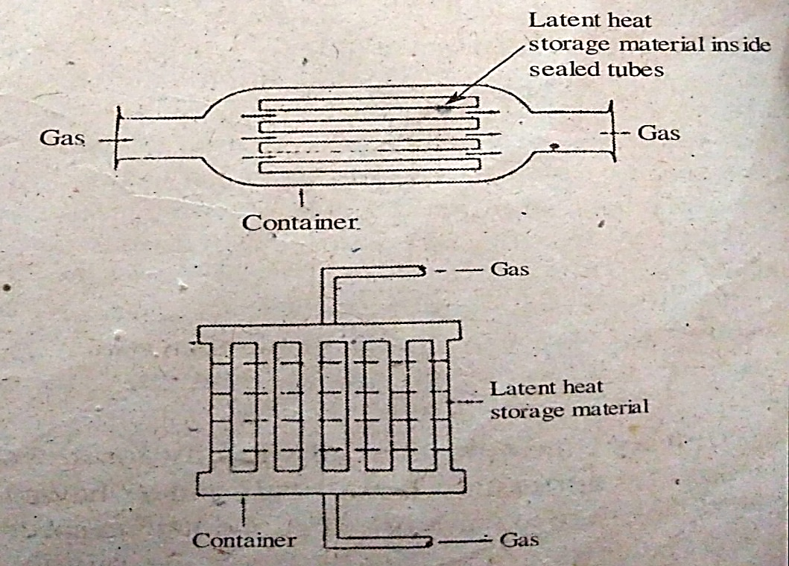
ii. Latent heat storage:
Fig: Arrangement for latent heat storage
In the latent heat storage, heat energy is stored by virtue of latent heat which is required to bring about phase change of storage medium.
The heat required to bring about phase change of a material is much larger compared to sensible heat change of the same material.
The phase change of a material also involves absorption or release of a large quantity of heat energy at constant temperature, which is impossible in the case of sensible heating and cooling.
Therefore, latent heat storage system is more compact for a certain heat storage compared to sensible heat storage system.

Slide 17
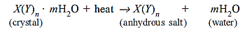
The phase change which can be used for storage system are solid–solid, solid–gas, solid–liquid and liquid–gas.
Solid–gas and liquid–gas transformation involves large volume changes, thereby making such storage systems impractical and complex.
However, solid–solid transition involves transformation of the material from one crystalline form to another, thereby resulting in the transformation with small volume changes.
Hence, such storage systems are practical and preferred in spite of small changes in latent heat possible during transformation.
For phase-change storage media, salt hydrates called Glauber’s salt (Na₂SO₄·l0H₂O) are preferred.
These have solid–liquid transformation. Besides hydrates, paraffins (C₁₈HS₆) and non-paraffins (ester, fatty acids, alcohols and glycols) are also suitable for such storage.
The hydrate crystals have water of crystallization and these can be represented by X(Y)n·mH₂O (one atom of X, n atoms of Y and m molecules of water in one crystal).
When hydrate crystals are heated to transition temperature, these crystals release their water of crystallization and anhydrous salt (hydrates without water) get dissolved in the released water.
The reaction is as follows:

Slide 18
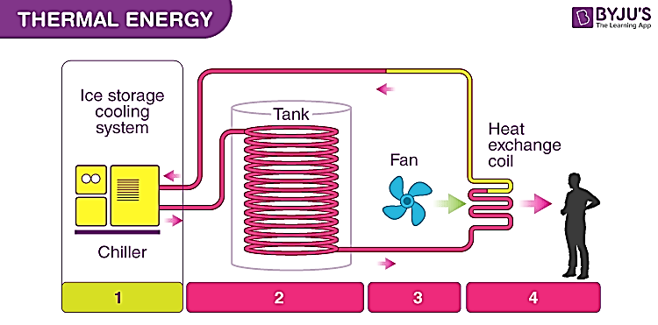
Stratified storage:
Stratified storage is a type of thermal energy storage where water is stored in layers (strata) of different temperatures inside a tank.
Stratified storage in solar energy systems refers to the technique of storing heated fluid (like water) in layers based on temperature, with warmer layers on top and cooler layers at the bottom.
This approach maximizes the efficiency of solar collectors and the utilization of stored heat.
Working:
Solar collectors: Devices that capture solar energy and heat a fluid (e.g., water).
Storage tank: A container that holds the heated fluid for later use.
Charging: When solar energy heats the fluid, the warmer fluid is directed to the top of the storage tank, while cooler fluid is drawn from the bottom for heating.
Discharging: When heat is needed, the warmer fluid is drawn from the top of the tank for use, while cooler fluid is returned to the bottom.
Thermal Stratification: The natural tendency of fluids to separate into layers based on temperature. Warmer, less dense fluids tend to rise, while cooler, denser fluids sink.
Fig: Stratified storage

Slide 19
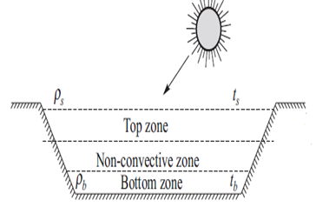
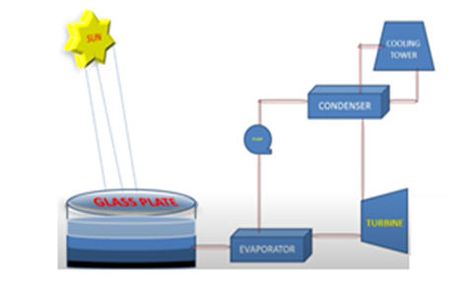
Solar Ponds:
Principle:
In ordinary pond, when water is heated up by the sun rays, the heated water rises to the top of the pond.
The hot water loses heat to the atmosphere, and so the net temperature at the top of the pond remains nearly at atmospheric temperature.
The solar pond technology ensures that heated brine water remains at the bottom of the pond due to more brine concentration and density in it.
Construction and working:
It consists of a large size brine pond (depth of about l m) which has salt concentration gradient.
A solar pond has three zones as shown in figure.
The top zone is surface zone which has the least salt content and its temperature is the atmospheric temperature.
The bottom zone has the maximum salt content and it has a high temperature (70–85°C).
This is the zone that collects and stores the solar energy as heat energy.
In between these two zones there is the gradient non-convective zone.

Slide 20
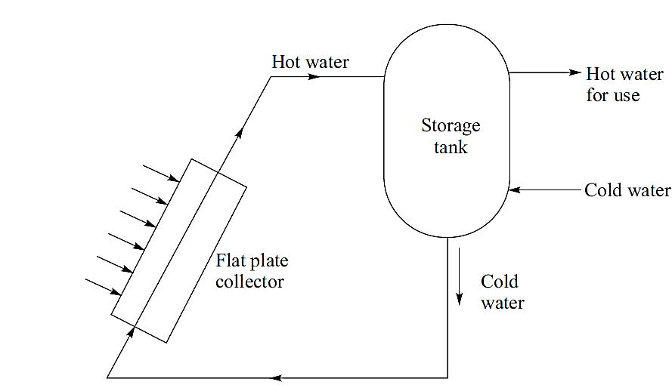
Solar water Heating:
Fig: Small capacity water heating system with natural circulation
It has two main components which include
Flat plate collector to convert solar radiation into heat energy and
Water storage tank to store hot water.
The tank is located above the level of collector.
Heat is transferred to the water in the solar collector and hot water rises to flow in the water tank.
The hot water enters the top of the water tank and cold water from the water tank moves out from the bottom of the tank so as to enter the inlet of the collector.
The hot water for use is withdrawn from the top of tank, which is replaced by cold water entering at the bottom of the tank.

Slide 21
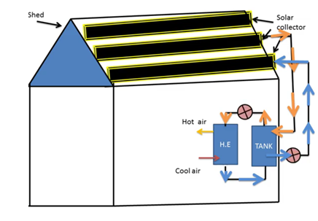
Space heating:
Solar space heating techniques circulate the heated liquid in a radiant heat system through piping in the walls or floors to allow the heat to naturally warm indoor spaces.
These are two solar thermal techniques that are commonly used:
Active heating
Passive heating
Active heating:
General principle for solar active heating is nearly all existing or proposed active solar space-heating and/or hot-water supply systems utilize three main components in addition to pumps and blowers:
A solar radiation collector with its associated heat transport (or heat-transfer) fluid
A heat-storage medium
A distribution system
In the collector the solar radiation is collected and converted into heat.
Fig: Solar active heating

Slide 22
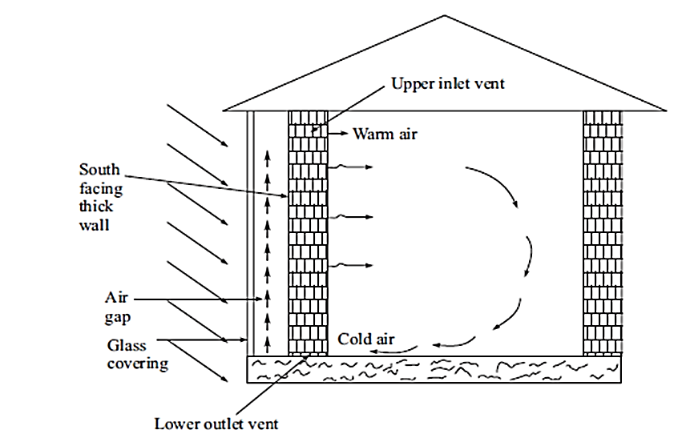
Passive heating:
Passive heating of building does not require any mechanical device.
In the northern hemisphere, the sun rays come from south direction.
Hence in order to achieve solar passive heating in cold regions, south facing wall is made thick using concrete or stones to store the maximum heat energy from the incident solar radiation.
The entire south wall is further provided with a plastic or glass sheet covering with an air gap in between the wall and the sheet covering.
The incident solar radiation after passing through the sheet covering is absorbed by the thermal storage wall.
The warm air in air gap rises and enters into the space inside the building to be heated as shown in figure.
The cold air is removed from the space from the lower outlet vents and warm air enters into the space from the upper inlet vents.

Slide 23
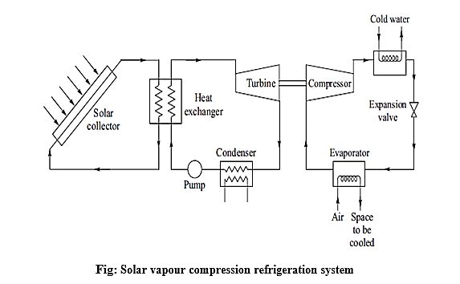
Solar cooling technique or solar refrigeration:
Refrigeration is a process of maintaining the temperature lower than the surroundings.
Usually there are two kinds of refrigeration systems are available,
Solar vapour compression refrigeration system
Solar absorption refrigeration system
Solar vapour compression refrigeration system:
Vapour compression system can be used for both cooling and heating.
If the vapour compression system takes heat from space and releases to atmosphere, it is working as cooling system.
On the other hand, if the vapour compression system takes heat from atmosphere and releases the same into the space, it is working as heat pump.
The vapour compression system working with solar radiation to cool a space is shown in figure.
Solar power is converted into mechanical work using turbine which then runs a compressor coupled with it.
The compressed refrigerant is expanded into evaporator, providing the requisite cooling.

Slide 24
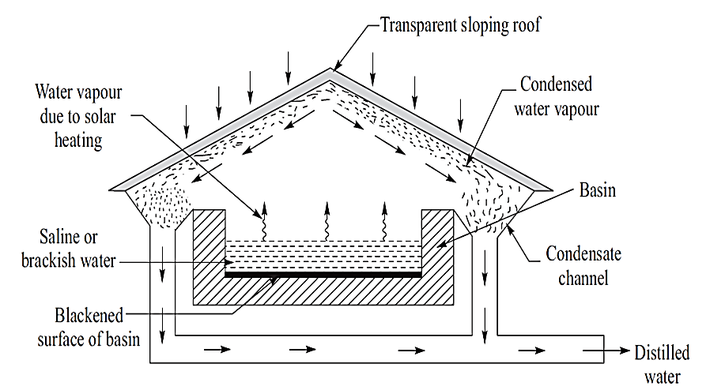
Solar distillation or solar stills:
It is used to purify the water.
The process to convert saline water into pure water using solar radiation is called solar distillation.
A solar device used for this purpose is called solar still.
A solar still consists of a shallow blackened basin filled with saline or brackish water to be distilled.
It is covered with sloping transparent roof as shown in figure.
The sun rays can pass through transparent roof and these rays are absorbed by the blackened surface of the basin, thereby increasing the temperature of water.
The water in basin evaporates due to solar heat and rises to the roof.
The water vapour cools down and condenses at the under surface of the roof.
The water drops or condensed water slip down along the sloping roof.
The condensed water is collected by the condensate channel and drained out from the solar still.

Slide 25
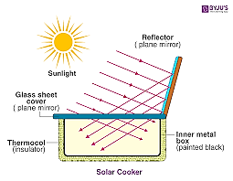
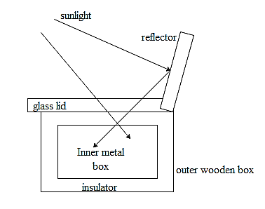
Solar cookers:
A solar cooker uses sunlight to heat and cook food.
It works by concentrating sunlight onto a cooking pot using reflective surfaces, and then trapping the heat within an insulated box or enclosure.
This trapped heat is used to cook the food.
Key components:
Reflector: A reflective surface (mirror or shiny metal) to focus sunlight.
Insulated Box: A box to trap heat, often with a transparent lid.
Cooking Pot: A dark-colored pot to absorb heat.
Glass or Plastic Cover: To allow sunlight in and trap heat.
Principle of operation:
Concentration: Solar cookers use reflective surfaces, like mirrors or shiny metal, to focus sunlight onto a small area, like a cooking pot.
Absorption: The concentrated sunlight is absorbed by the dark-colored pot and the interior of the cooker, converting light energy into heat energy.
Insulation/Heat Retention: The cooker is often designed with a transparent cover (like glass or plastic) and insulated walls to trap the heat inside, preventing it from escaping.
Fig: Solar cooker

Slide 26
Descriptive questions
Define and classify the solar collectors.
Illustrate the flat plate collector with a neat sketch.
Demonstrate different types of concentrating collectors with neat sketch.
What is meant by solar energy storage? Mention the various solar energy storage systems.
Explain the different techniques of solar space heating.
Illustrate production of the cooling by using solar systems.
Explain the working of solar stills.
Describe the construction of solar ponds.
Describe the working of solar cooker.
Discuss the central power tower concept.
Short answerer questions
What is the working principle of solar collector.
List the features of solar collectors.
What are demerits of solar collectors.
Define solar pond.
Draw the neat sketch of solar drier.
Assignment questions
Derive the equation for mathematical analysis of flat plate collectors.
Elucidate the orientation of concentrating collectors.
Illustrate the solar driers with neat sketch.
Demonstrate the solar chimney with a neat sketch.

